Slide 1
Preparing Mathematicians for Big Data Careers An Insider’s Perspective
Paul Raff
Principal Data Scientist, Microsoft
Presentation to the <>
January 7, 2016

Slide 2




About Me
 | 2004 – BS Mathematics, BS Computer Science
 | 2009 – PhD Mathematics
 | 2010 – Applied Researcher, Supply Chain Research
 | 2012 – Principal Data Scientist, Analysis and Experimentation

Slide 3
Our Team
Microsoft’s Analysis and Experimentation Team
Accelerating innovation via trustworthy analysis and experimentation

Slide 4
Our Experience Hiring Data Scientists
I’ve been in charge of recruiting for the past 2 years, so I have been in contact with most/all of our candidates in the process.
500 | Applications considered
250 | First phone screens
120 | Second phone screens
60 | Onsite interviews
20 | Offers for employment given

Slide 5
The Data Science Venn Diagram
Understanding the Data Science Venn Diagram can help faculty better prepare their students for careers in data science.
Let’s go through the venn diagram piece by piece and discuss how this can shape and inform.
Computer Science
Skills
Mathematics/
Statistics
Knowledge
Machine
Learning
Scientist
Data
Scientist
Danger
Zone!
Traditional
Researcher
Substantive Expertise
Domain Knowledge
Thanks to Drew Conway

Slide 6
The Data Science Venn Diagram
This is where we are. Most of our efforts are focused on this area of the venn diagram.
Computer Science
Skills
Mathematics/
Statistics
Knowledge
Machine
Learning
Scientist
Data
Scientist
Danger
Zone!
Traditional
Researcher
Substantive Expertise
Domain Knowledge
Thanks to Drew Conway

Slide 7
The Data Science Venn Diagram
This is where we are. Most of our efforts are focused on this area of the venn diagram.
So, luckily, by being in this area we prevent our students from being in the so-called danger zone.
Computer Science
Skills
Mathematics/
Statistics
Knowledge
Machine
Learning
Scientist
Data
Scientist
Danger
Zone!
Traditional
Researcher
Substantive Expertise
Domain Knowledge
Thanks to Drew Conway

Slide 8
The Data Science Venn Diagram
Now, consider the top two areas: computer science and math/stats.
These two pieces are equally-sized, and that is important.
We can never do too much computer science in a math/stats department, and there should be computer science components in all classes that can admit it.
Computer Science
Skills
Mathematics/
Statistics
Knowledge
Machine
Learning
Scientist
Data
Scientist
Danger
Zone!
Traditional
Researcher
Substantive Expertise
Domain Knowledge
Thanks to Drew Conway

Slide 9
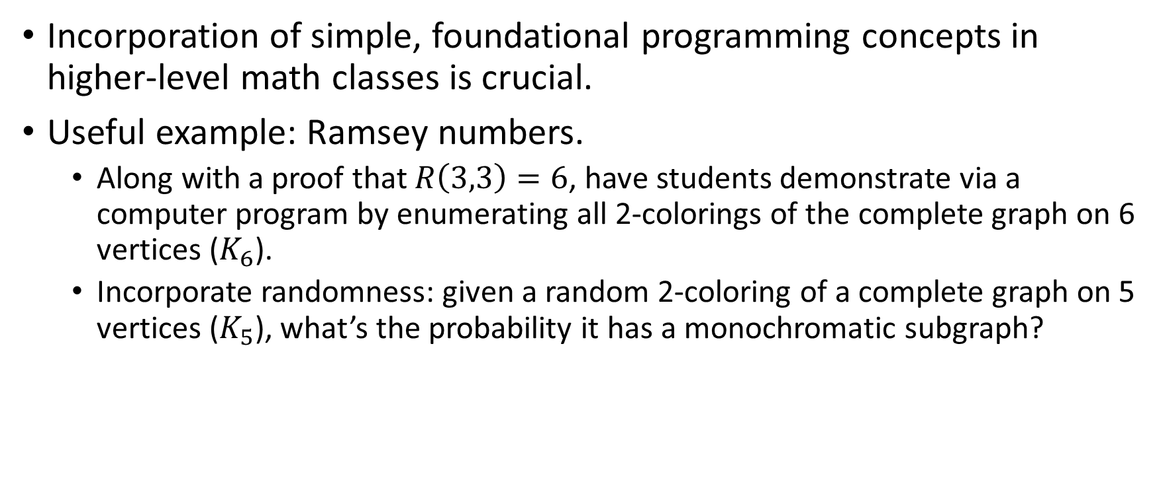
Effective Computer Science for Mathematicians and Statisticians
Incorporation of simple, foundational programming concepts in higher-level math classes is crucial.
Useful example: Ramsey numbers.
Along with a proof that $R\left(3,3\right)=6$, have students demonstrate via a computer program by enumerating all 2-colorings of the complete graph on 6 vertices ($K_{6}$).
Incorporate randomness: given a random 2-coloring of a complete graph on 5 vertices ($K_{5}$), what’s the probability it has a monochromatic subgraph?

Slide 10
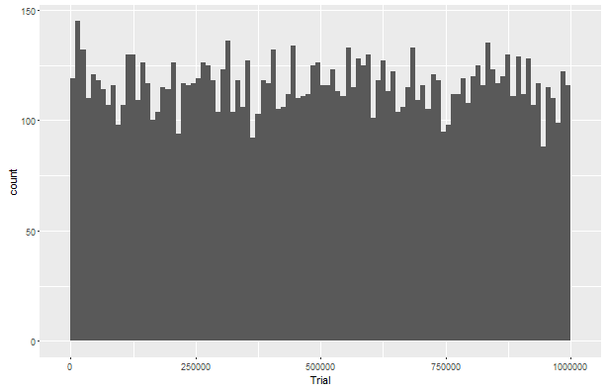
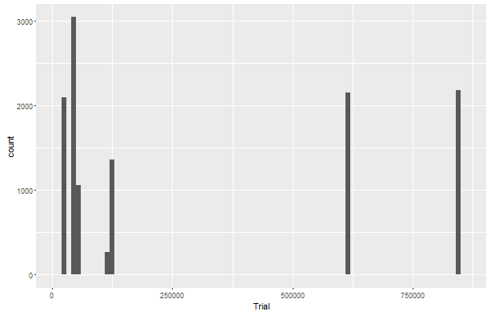
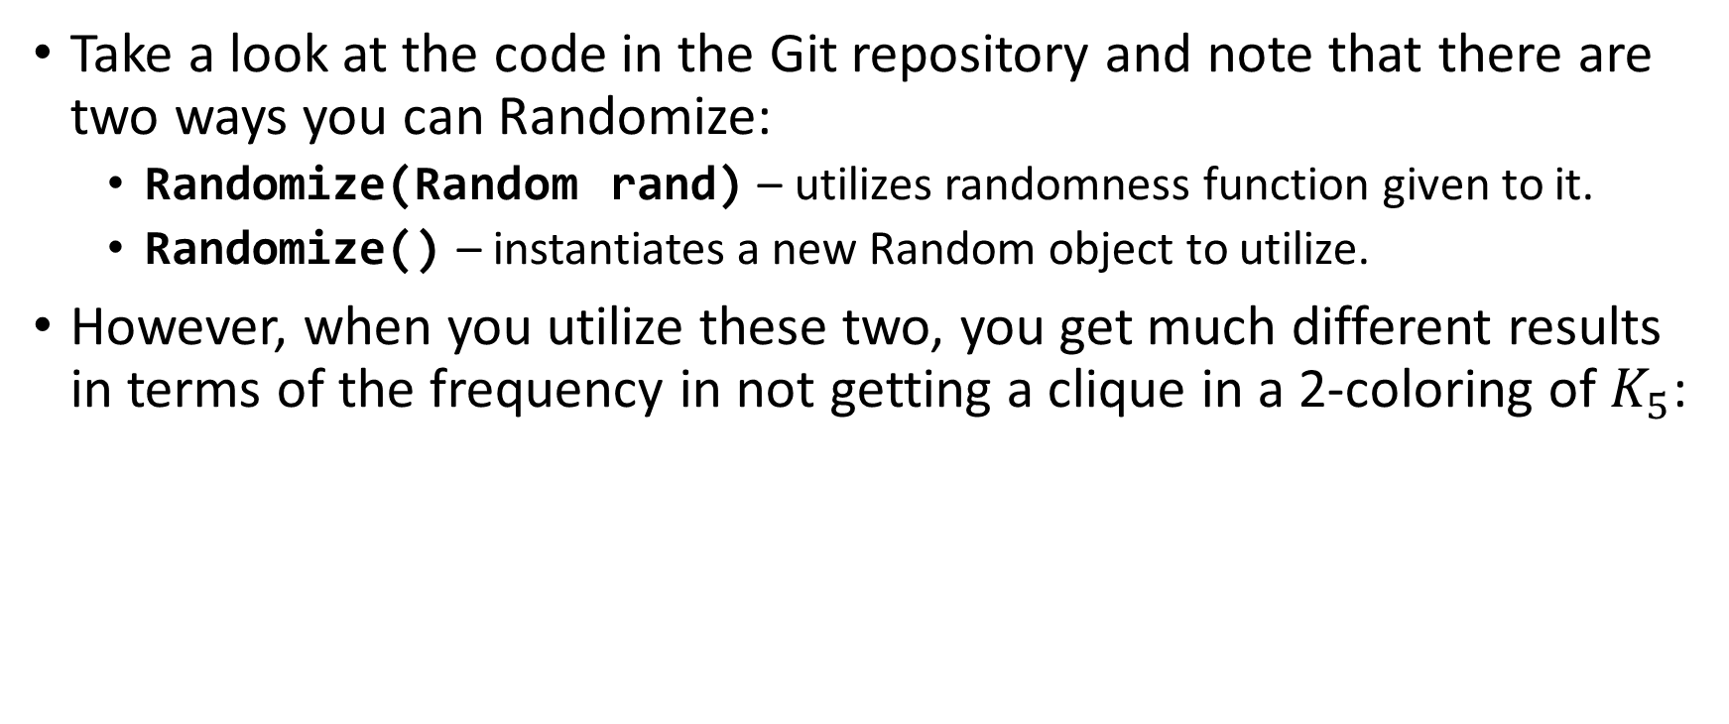
Ramsey Numbers in Detail
Take a look at the code in the Git repository and note that there are two ways you can Randomize:
Randomize(Random rand) – utilizes randomness function given to it.
Randomize() – instantiates a new Random object to utilize.
However, when you utilize these two, you get much different results in terms of the frequency in not getting a clique in a 2-coloring of $K_{5}$:
Using common random function throughout
Using new random function each call

Slide 11
Ramsey Numbers in Detail What’s Going On?
Even without this complication, it’s a good lesson in basic end-to-end programming skills.
However, now this has itself turned into a data science problem.
Given our normal expectations, what should we see?
Why are we seeing something else?
Good lesson for the Substantive Expertise/Domain Knowledge bucket – how systems work does not necessarily align with our expectations.
Hint towards why we observe what we’re observing.

Slide 12
The Data Science Venn Diagram
Now let’s focus on this part.
How to get students more access to this part? Summer internships and connections to the industry.
However, most of the avenues that are available are focused/biased towards engaging students that are in graduate school.
Computer Science
Skills
Mathematics/
Statistics
Knowledge
Machine
Learning
Scientist
Data
Scientist
Danger
Zone!
Traditional
Researcher
Substantive Expertise
Domain Knowledge
Thanks to Drew Conway

Slide 13
The Data Science Venn Diagram
Understanding the Data Science Venn Diagram can help faculty better prepare their students for careers in data science.
Let’s go through the venn diagram piece by piece and discuss how this can shape and inform.
Computer Science
Skills
Mathematics/
Statistics
Knowledge
Machine
Learning
Scientist
Data
Scientist
Danger
Zone!
Traditional
Researcher
Substantive Expertise
Domain Knowledge
Thanks to Drew Conway

Slide 14
The Data Science Venn Diagram
First of all, note that by fulfilling the needs in this area, you ensure that your students never end up in this area.
Unless, of course, the student fails to persist what he/she has obtained.
Computer Science
Skills
Mathematics/
Statistics
Knowledge
Machine
Learning
Scientist
Data
Scientist
Danger
Zone!
Traditional
Researcher
Substantive Expertise
Domain Knowledge
Thanks to Drew Conway

Slide 15
The Data Science Venn Diagram
Also note that there are three very legitimate areas for a budding mathematician to end up in. All of them are valuable, so it’s important that the student understands the differences between the two areas, since in a lot of cases companies treat the following as such.
Computer Science
Skills
Mathematics/
Statistics
Knowledge
Machine
Learning
Scientist
Data
Scientist
Danger
Zone!
Traditional
Researcher
Substantive Expertise
Domain Knowledge
Thanks to Drew Conway

Slide 16
The Data Science Venn Diagram
As an educator you have the ability to primarily influence these components.
Also note that they are equally-sized. This is important, and correct.
Computer Science
Skills
Mathematics/
Statistics
Knowledge
Machine
Learning
Scientist
Data
Scientist
Danger
Zone!
Traditional
Researcher
Substantive Expertise
Domain Knowledge
Thanks to Drew Conway

Slide 17
Effective Computer Science for Mathematicians

Slide 18
The Data Science Venn Diagram
What’s the difference between the three?
Traditional researcher – no realistic use of data, in most aspects.
Machine learning scientist – utilizes data heavily and extensively, but is often more abstract and not product-focused.
Data scientist – focused on the product, focused on how data is necessary for understanding the product, improving the product, and optimizing the product.
Computer Science
Skills
Mathematics/
Statistics
Knowledge
Machine
Learning
Scientist
Data
Scientist
Danger
Zone!
Traditional
Researcher
Substantive Expertise
Domain Knowledge
Thanks to Drew Conway

Slide 19
Digression – Geeking out on Rand()
A naïve implementation of this situation would use Rand() inside the randomize function, which results in very interesting behavior.

Slide 20
The Data Science Venn Diagram
Also, note what’s not available when you are lacking mathematics and statistics knowledge. This is important. When a student is choosing between a computer science major and a mathematics major, then that student should choose mathematics.
Computer Science
Skills
Mathematics/
Statistics
Knowledge
Machine
Learning
Scientist
Data
Scientist
Danger
Zone!
Traditional
Researcher
Substantive Expertise
Domain Knowledge
Thanks to Drew Conway

Slide 21
The Data Science Venn Diagram
Understanding the Data Science Venn Diagram can help faculty better prepare their students for careers in data science.
Computer Science
Skills
Mathematics/
Statistics
Knowledge
Machine
Learning
Scientist
Data
Scientist
Danger
Zone!
Traditional
Researcher
Substantive Expertise
Domain Knowledge
Thanks to Drew Conway

Slide 22
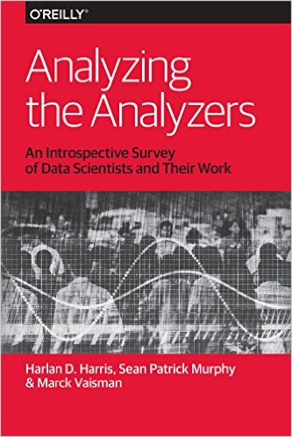
Resources
Analyzing the Analyzers
Useful summary of the different types of data scientists that exist.
Data Businesspeople
Data Creatives
Data Developers
Data Researchers

Slide 23
Appendix

